Slide 1
Digital Signal Processing
Adaptive Line Enhancement
Hanbyeol Lee Jiyoung Ok

Slide 2
Context
Concept
Difference by Changing Parameters
Results
Application to Music
Reference
Compare to MATLAB

Slide 3
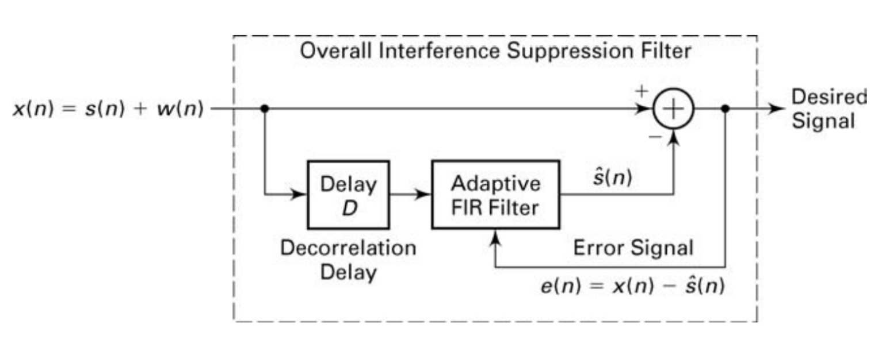
Concept
$$a=100, A=10, M=2000, w_{0}=\frac{π}{4},N=10,Δ=3×{10}^{−7}$$

Slide 4
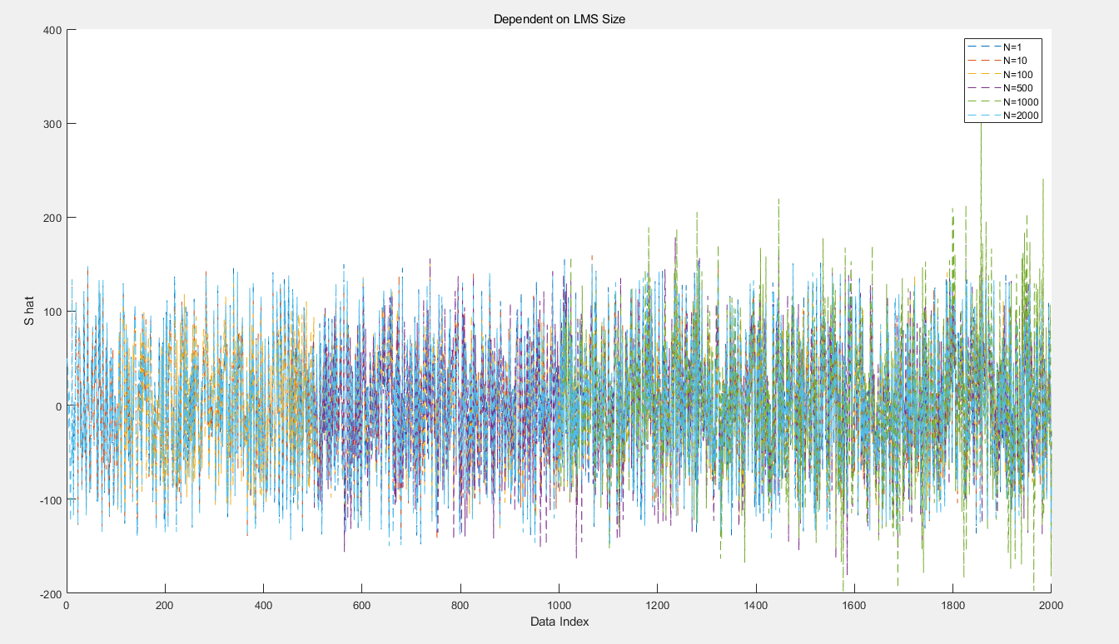
Difference by Changing Parameters
$$N=1, 10, 100, 500, 1000, 2000$$
$$A=10, a=100, M=2000, w_{0}=\frac{π}{4},Δ=3×{10}^{−7}$$

Slide 5
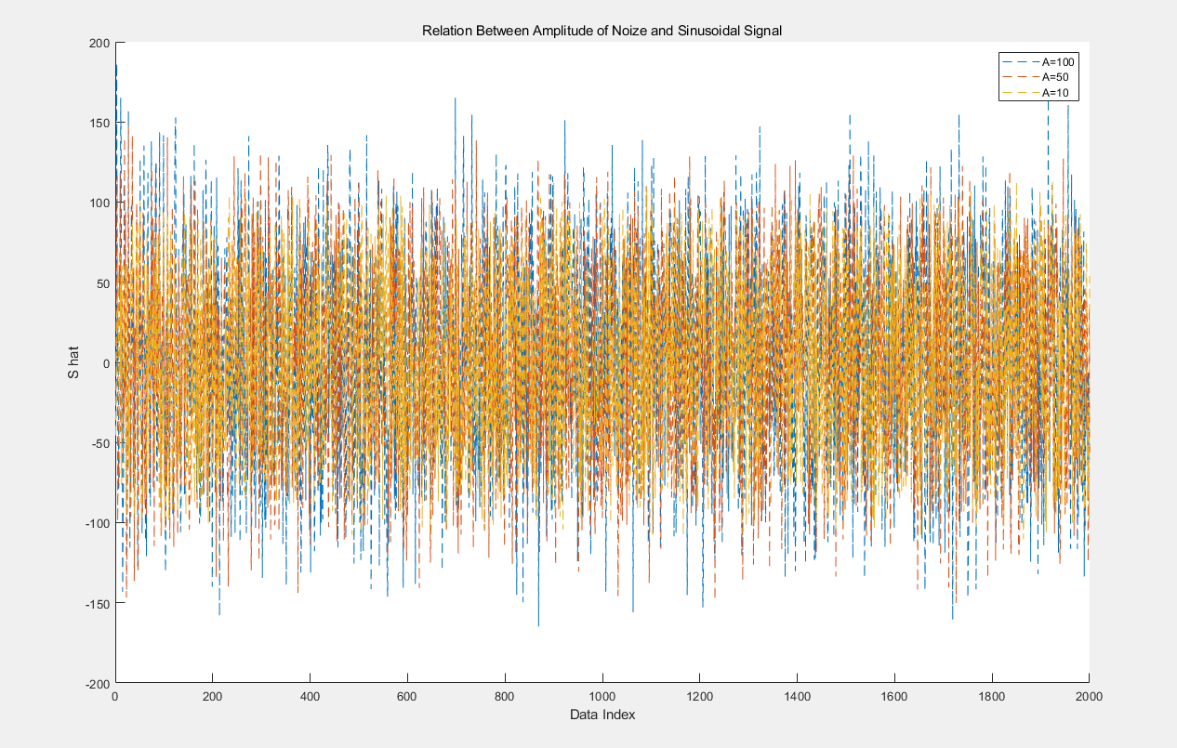
Difference by Changing Parameters
$$A=10, 50, 100$$
$$a=100, M=2000, w_{0}=\frac{π}{4},Δ=3×{10}^{−7}, N=10$$

Slide 6
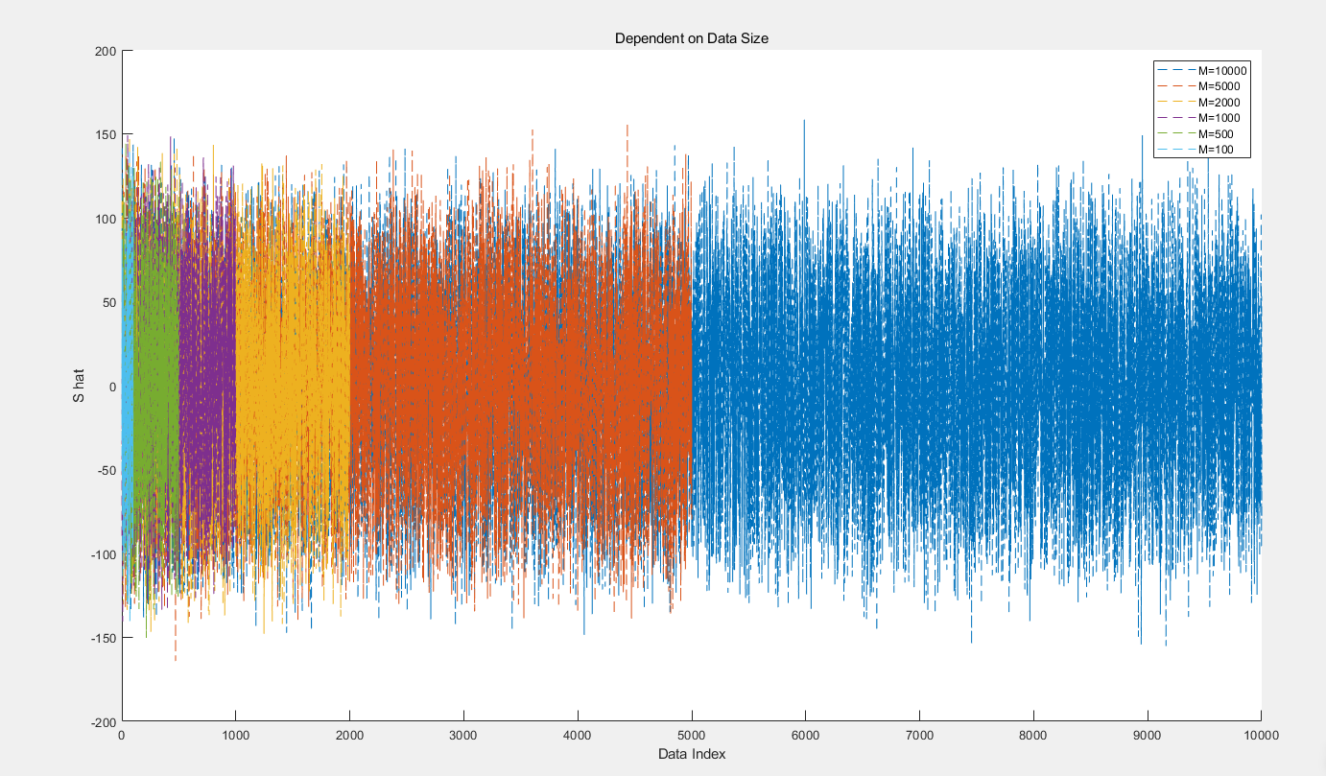
Difference by Changing Parameters
$$M=100, 500, 1000, 2000, 5000, 10000$$
$$A=10,a=100, w_{0}=\frac{π}{4},Δ=3×{10}^{−7}, N=10$$

Slide 7
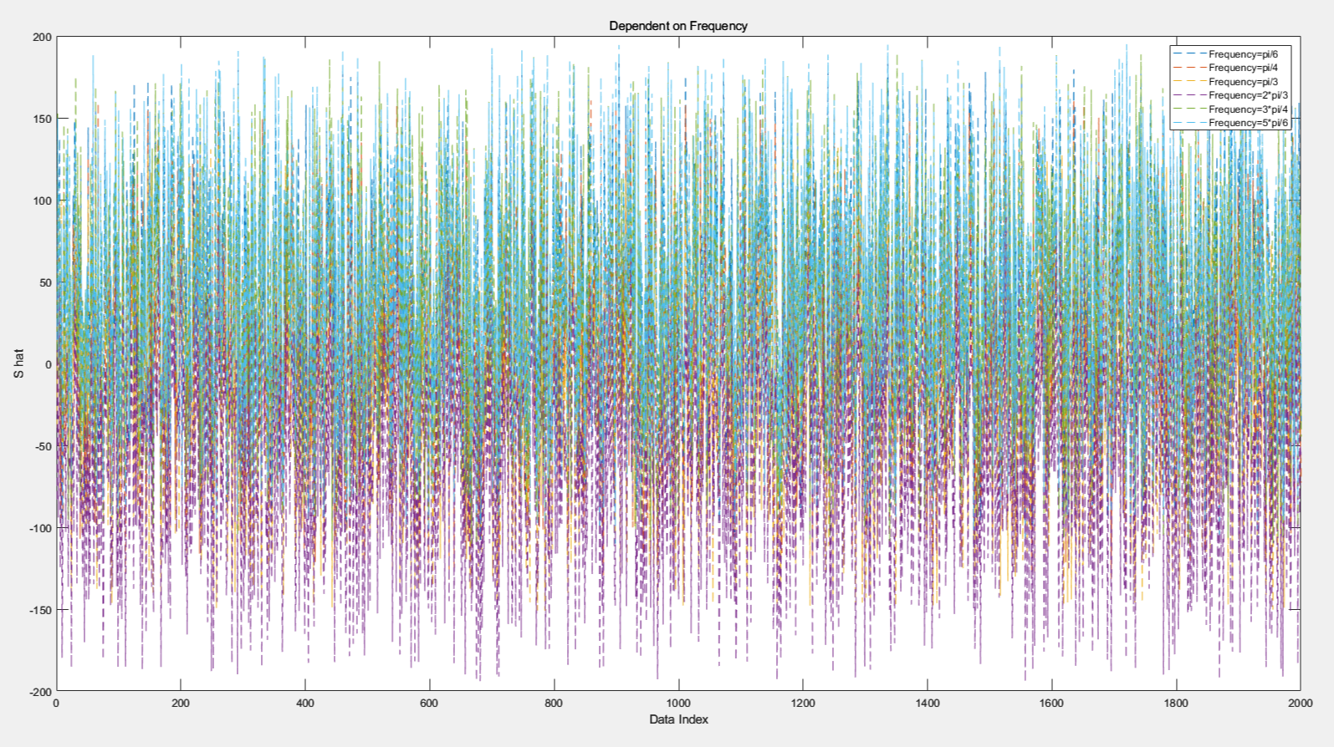
Difference by Changing Parameters
$$w_{0}=\frac{π}{6},\frac{π}{4},\frac{π}{3},\frac{2π}{3},\frac{3π}{4},\frac{5π}{6}$$
$$A=10,a=100, M=2000,Δ=3×{10}^{−7}, N=10$$

Slide 8
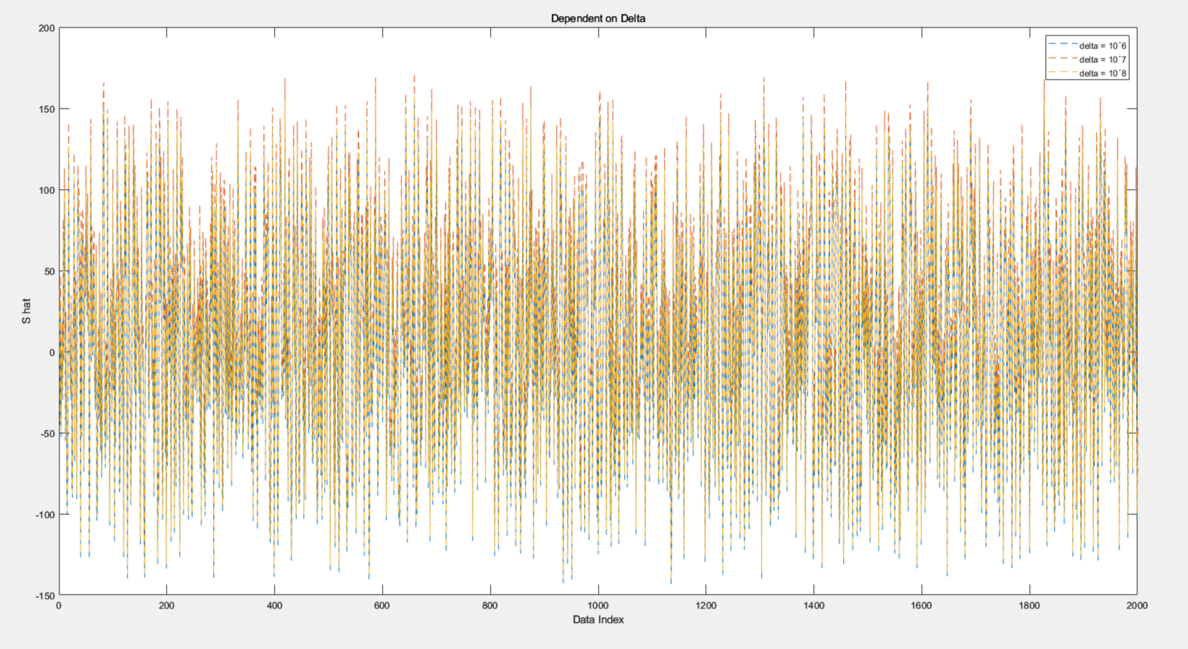
Difference by Changing Parameters
$$Δ={10}^{−6}, {10}^{−7}, {10}^{−8}$$
$$A=10,a=100, M=2000,w_{0}=\frac{π}{4}, N=10$$

Slide 9
Results
Only LMS Filter Size and Sinusoidal Signal’s Amplitude can affect

Slide 10

Application to Music
Original Sound
Original Sound + Noise
ALE {Original Sound + Noise}

Slide 11

Compare to MATLAB
Original Sound
Sine Noise
Original Sound with Sine Noise
ALE{Original Sound with Sine Noise}

Slide 12
Compare to MATLAB
Original Sound
Original Sound with FM Noise
ALE{Original Sound with FM Noise}

Slide 13
Reference
[1] J. L. Flanagan, J. D.Johnston, R. Zahn and G . W. Elko, “Com- puter-steered microphone arrays for sound transaction in large rooms,”J.Acoust. Soc. Am., 78, pp. 1508-1518,Nov. 1985.
[2] S. F. Boll, “Suppression of acoustic noise in speech using spec- tral subtraction,”IEEE Trans. Acoust.. Speech, Signal Process- ing, vol. ASSP-27, no. 2, pp.113-120, April 1979
[3] “How to generate noise signal with desired max and min signal?” Mathworks.https://kr.mathworks.com/matlabcentral/answers/1753630-how-to-generate-noise-signal-with-desired-max-and-min-signal (June 8th, 2023).
[4] K. Sumi, N. Sasaoka, Y. Itoh and K. Fujii, “Smart noise reduction method for sinusoidal and wideband noise using adaptive line enhancer and noise reconstruction filter”The 2004 47th, Midwest Symposium on Circuits and Systems, 2004, Nov. 2004
[5] V. K. Ingle and J. G. Proakis, Digital Signal Processing using MATLAB, 3rd, ed. Stamford, CT :Cengage Learning, 2010.

